Slide 1
Spontaneous Combustion
By, Michael Weyman

Slide 2
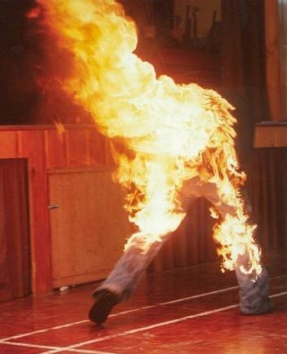

Slide 3
What is it?
Spontaneous Combustion is combustion without any external ignition source
Most commonly affects hay stacks
Also effects oil, coal, pyrite, and pistachio nuts
Could also affect humans, but not proven yet

Slide 4
Main Causes
When the substance has a low ignition point
The substance is unable to allow heat to escape
The temperature rises above ignition point and oxidizes, causing substance to combust
Once the substance is burnt the flames stop

Slide 5
SHC????
Spontaneous Human Combustion!!!
Has not yet been proven true
There are several cases where this was claimed the cause
Affects smokers and alcoholics
May also be caused by static electricity

Slide 6
Death of Michael Faherty
Happened in Ireland Dec. 22, 2010
76 year old man
Found burned to death
Burns only found on body, floor beneath him, and ceiling above him
Most probable case of SHC

Slide 7
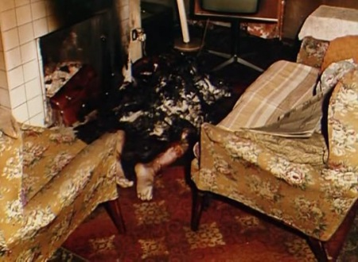

Slide 8
In Conclusion
BE WARNED!!!

